Slide 1



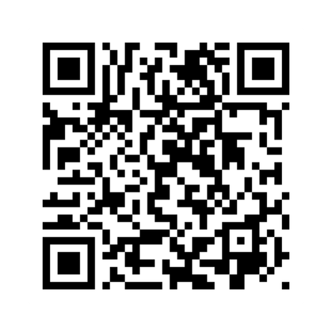





CENTRAL AREA CHURCHES
A Night Of
WORSHIP
REGISTER HERE
Please reserve for dinner by 4/24/26, Include in registry form: name/s for dinner, food allergies & if childcare is needed.
Hosted by Aurelius Baptist Church
MAY 1ST 2026
Speaker: Holly Collins
Worship Director, Redeemer Fellowship, Monroe
6 PM DINNER | 7 PM WORSHIP
www.ABC-MI.org

